Slide 1
CAreers in the Wood-Related Industries

Slide 2
Segments of the industry
Primary -- Sawmill and forestry operations, extracting and milling of logs
Secondary -- Wood products manufacturing such as cabinets, millwork, furniture and other wood products
Suppliers -- Companies that make the machinery and supplies used in wood products manufacturing such as CNC routers, saws, edgebanders, wood panels, flooring, veneers, hardware, soft goods such as upholstery and bedding materials

Slide 3
All sectors need skilled workers
Just like any other industry, there is a vast range of job types, from sales and marketing, to design, computer skilled jobs, machine operation, plant supervision and many more.
This PowerPoint is just a small sampling of the varied jobs within the industry.

Slide 4
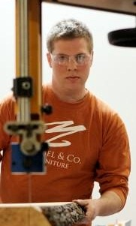
Job position #1: Owner, Furniture design company
Martin Goebel, Co-Founder,
Director of Production
Goebel & Co. Furniture
Innovative furniture design company, St. Louis, MO

Slide 5
Job Characteristics
Create product designs (prototyping)
Manage production, manufacturing, the supply chain, contractors and client relations
Work with vendors, retailers and clients
Notes:
Martin’s company creates solid wood, residential furniture with a tech-based manufacturing process, using 3-D computer modeling and CNC (Computer Numerical Control) fabrication coupled with handcraft. In addition to designing his pieces, as a small business owner Martin must oversee the manufacturing process, order inventory, work with a variety of suppliers, calculate his costs – and learn how to work with and please the client!

Slide 6
Martin created the design for “Cruz Stool” with 3-D modeling software; he produces it with CNC technology. He then creates custom finishes to please a variety of customers.
Notes:
Martin uses 3-D computer modeling for his pieces that combine the technology of CNC fabrication with handcrafted elements in the sanding and finishing. This manner of production is referred to as “mass customization.” It allows for multiple pieces to be created quickly and efficiently with machine runs that can then be individually customized in some fashion to offer variety to consumers. For Martin, a run consists of 10-50 stools—anything over 30 achieves production efficiency so they aim for that. There are different profit margins and costs when producing for wholesale vs. retail sales. When they are coupled in production, it helps level out the costs. Understanding costs and profits is key to a small business owner.

Slide 7
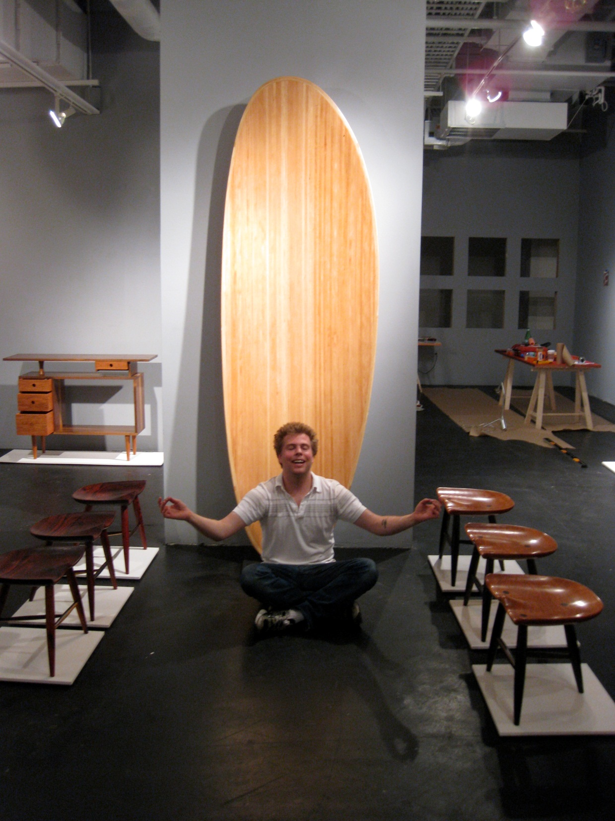
Notes:
Martin began work on the Cruz stool in grad school. The design and production process constituted his Master’s thesis at Rhode Island School of Design. (Martin has a passion for well-made objects. He remembers destroying furniture as a kid and while intent on making more faster, he doesn’t lose sight of quality materials and craftsmanship.)

Slide 8
This table was made from a salvaged log like those in the photo.
Martin seeks out wood in the community slated for removal or felled by storms.
Notes:
Martin is able to get much of this wood for free. He also buys salvaged wood through sawmills, where any metals are removed and it is dried and milled.

Slide 9
job position #1: Owner
Martin’s Background:
Fine Woodworking Certificate from College of the Redwoods, CA
BFA, Studio Fine Arts, University of Missouri
MFA, Furniture Design, Rhode Island School of Design
Notes:
Martin first started a custom furniture business after receiving his certificate from the College of the Redwoods and he could have continued in that vein. Because he is very passionate about woodworking and learning, he chose to go back to school and further his education before once again opening the doors of a furniture company.

Slide 10
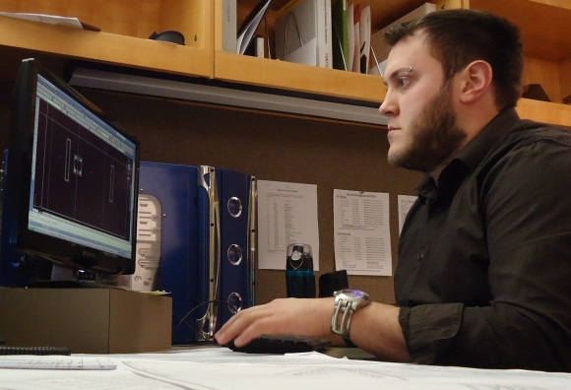
Job position #2: Engineer Tech and estimator
Adam Kessler, Engineer Tech and Estimator
DatesWeiser Furniture Corporation
Buffalo, NY

Slide 11
Job Characteristics
Create CAD drawings, taking into account any material limitations
Get quotes for materials or fabrication needing to be outsourced
Calculate material and labor costs for furniture pieces
Check final drawings for accuracy; prepare cut lists, itemized materials and finishes lists and bill of materials for production
Notes:
As an estimator, Adam gets a brief description and a concept, a hand sketch, CAD drawing or architect’s rendering of a piece of furniture. He drafts his representation of it, with the company’s construction methods in mind, and uses his CAD drawings to get quotes for materials his factory does not fabricate such as glass and stone tops and metal components. He writes up a quote breaking down each furniture piece into components, finishes and other costs.
As an engineer, he reviews drawings that have gone through several revisions, to verify accuracy before production. After multiple reviews with other engineers, the project manager, floor manager and materials manager, the piece is released to the factory floor for construction.

Slide 12
Adam is making job packets to go to the factory floor. These include the drawings, cut sheets and bill of materials.

Slide 13
Adam checks out a table on the factory floor. The table has power/data boxes with lids, a microphone/
speaker plate (that he designed) and a flat screen TV that pops up out of the base.

Slide 14
This is a custom table Adam designed for a company client. It has a solid walnut edge, leather panels, metal inlays and a metal field. He created a “waterfall” edge and a mechanism to open the table into two halves. Co-workers contributed other aspects to the design.
Notes:
The mechanism created for this piece was considerably more cost effective than previous tables that the company had built.

Slide 15
Fresh Wood competition winner in 2011!
Notes:
Adam won 2nd place in the Tables category and the People’s Choice award in the 2011 Fresh Wood student competition for his piece entitled, “Table for Dali.” The competition, which is open to high school and college students, is sponsored by the Association of Woodworking & Furnishings Suppliers, an industry group that encourages students to join the woodworking industry.

Slide 16
Job position #2: engineer tech and estimator
Adam’s Background:
Monroe Community College, Rochester, NY, A.S.
Buffalo State College, B.S. in Wood/Furniture and B.S. in Fibers Design
Notes:
Adam started out studying architecture but didn’t like the complex building plans. He then focused on sculpture but wanted something more substantive than looking at art pieces. He took time off, worked in the pizza business, got tired of that, and decided to go back to school in Furniture Design. This appealed to him as it combined some of architecture and sculpture, and the end product was useful and functional. He decided to also pursue a Fibers Design major and for several years spent all his time in the studios. He entered his projects in shows and exhibitions and took extra classes because he wanted to learn as many skills as he could. He received the Dean’s Award for Design and was hired three months after graduating.

Slide 17
Job position #3: Inspector of Finished carpentry
Randa Vargas, Director of Architectural Services
Woodwork Institute
Southern California

Slide 18
Job Characteristics
Deliver seminars to architects, general contractors and manufacturers on finish carpentry topics
Review construction documents for compliance based on the Architectural Woodwork Standards manual
Inspect manufacturers’ shop drawings, product, product assembly, site conditions and installation
Notes:
The Woodwork Institute, for whom Randa works, is the co-author of the Architectural Woodwork Standards manual with the Architectural Woodwork Institute and the Architectural Woodwork Manufacturers Association of Canada. By working together, the three groups have created one comprehensive millwork manual for North America.

Slide 19
Randa makes a site inspection to determine if the jobsite is compliant. A log tag device (in photo foreground) is used to track temperature and humidity of the room, critical for the installation process.
Notes:
This is the North Hollywood Library where they hold city council meetings. The general contractor and millwork manufacturer do all they can to maintain the environment of the room for the best installation results. If the room does get out of range, the manufacturer can address the condition using heaters or hvac to bring the room into the compliant range for casework. (A non-acclimated building could cause damage to joints, seams, drawer closure, etc. Wood moves and breathes!)

Slide 20
Randa (right) served as the Editor of the newsletter for the San Diego chapter of the Construction Specifications Institute (CSI).
Notes:
In college Randa pursued a law enforcement career. To pay for college, she went to work for a home builder. From there she went on to work for a sub-contractor of nine different trades, learning all aspects of the commercial construction business. She likes the “t-shirt and jeans” field aspect of her job as well as the office work, where she “gets slicked up to do seminars.”

Slide 21
JOB POSITION #3: Inspector of Finished Carpentry
Randa’s Background:
Chaffey College, Rancho Cucamonga, CA
Ongoing workshops, seminars and webinars to stay current with industry

Slide 22
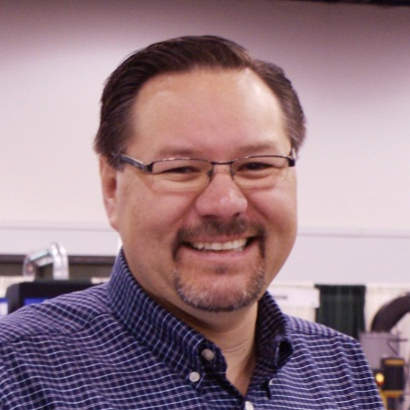
Job position #4: Shop superintendent
Saúl Martín, Shop Superintendent
Architectural Woodworking Company
Monterey Park, CA
Notes:
AWC manufactures high-end architectural millwork. Their clientele ranges from high-end residential to Fortune 500 companies. The bulk of their work comes from architects and designers, whose visions they bring to fruition. Their work has been featured in many notable magazines, specifically Architectural Digest and Interior Design.

Slide 23
Job Characteristics
Oversee all shop activity to ensure maximum productivity
Create/change drawings and generating programs
Supervise plant crew, hire and fire, train and cross-train
Diagnose and repair machines that are down and return to fully functioning state ASAP
Ensure procedures for safe and clean working environment
Notes:
Saul enjoys what he does and is passionate about woodworking but he also likes machinery, tools and computers. In the last few years, he is spending more time programming and repairing CNC equipment—which he considers fun!

Slide 24
Saúl (right) and co-worker review a blueprint to determine specific details to be completed before shipping.

Slide 25
Preparing a case that will be trimmed out.

Slide 26
Saúl and co-worker at the Point to Point machine computer screen going over parameters of horizontal boring.
Notes:
When there are intricate parts to be made, Saul creates a drawing and generates a program for the Point to Point.

Slide 27
Interiors created by AWC
Notes:
The shot on the left is a law firm in downtown Los Angeles, showing the faceted wall paneling installed by AWC—part of a 6-floors job. On the right is a reception area for Univision Studios, a Los Angeles Spanish TV station, where AWC created the reception desk, wood columns, credenza, jumbo-tron and the feature wall of louvered glass let into tall wooden columns.

Slide 28
Job position #4: Shop superintendent
Saúl’s Background:
Los Angeles Trade Technical College
Local 721, Cabinetmakers and Millmen, California Journeyman’s Card
Professional courses in AutoCAD, CNC, Lean Mfg., Advanced Excel, Point to Point
Notes:
Saul is active with Skills USA and with the World Skills qualifying trials, garnering supplies for the competitions and acting as a judge. He also hosts teachers at his shop to share industry practices with them. Saul also serves on industry advisory committees to contribute his expertise to the field at large.

Slide 29
What advice do these people have for you?
Getting a degree can’t hurt!
We are all born with different talents, skills and abilities. We add to these through education and experience. No matter what your job, be involved, show up and learn from the opportunity.
Learn from the ground up—don’t think you are going to start at the top.
Stay engaged in your technical courses. These skills are desperately needed in the woodworking industries.

Slide 30
What advice do these people have for you?
Find out as much as you can about the industry. Join industry associations.
Learn to work with different materials and develop as may skills as possible. If interested in the furniture world, learn CAD.
Enjoy what you are doing! Don’t be afraid to make mistakes—they are learning experiences.

Slide 31
Identify your strengths and preferences
Do you like… | Then you might like…
Working with, meeting and talking to people? | Sales, marketing, team leader, management
Tinkering and fixing things? | Machine operator, machine technician, furniture repair/restoration, hardware sales/installation
Designing and creating | Furniture or cabinet maker, product designer, machinery design/engineering

Slide 32
Identify your strengths and preferences
Do you like… | Then you might like…
Organizing, creating order and efficiency | Plant manager, office administrator, procedures developer, quality management
Motivating people, public speaking | Team captain, product trainer, teacher, inspector
Computers | Product design, drawing, CNC operator, marketing, social media expert

Slide 33
If you have identified the woodworking industry as right for you…
there is a place for you, no
matter where your interest
lies!

Slide 34
Industry facts
U.S. manufacturing has added workers in 2010, 2011 and 2012. But one thing holding back more growth is...
There are currently over 600,000 unfilled positions in U.S. manufacturing due to the lack of skilled labor.
the availability of skilled workers.

Slide 35
Industry facts
Today’s modernized plants lean heavily on computers, software and automation, a trend referred to as “advanced manufacturing.”
The hands-on experiences you gain in CTE classes will give you an edge in adapting to these advanced systems.

Slide 36
Manufacturing facilities today are clean, bright, appealing places to work.

Slide 37
Sample Salary Survey
This is an estimated guide to salaries which will fluctuate depending on number of years and breadth of experience as well as on geographic region.
Occupation Hourly Rate
Cabinetmaker $13-40
Coating, Painting and Spraying Machine $16
Operator
Computer and Info Systems Mgr $47
Computer Controlled Machine Operator $16-17
Designer $13-40
Drafter $20
Estimator $13-40
Finisher $15

Slide 38
Salaries, cont.
Foreman $18-40
Inspector $18-20
Installation, Maintenance and Repair $23-25
Machinery Maintenance Worker $20
Marketing Manager $46
Material Handler $13
Project Manager $28
Sales, Mfg. Technical Products $36-40
Supervisor of Production and Workers $22-28
Woodworking Machine Setter, Operator $13-14
From Occupational Employment Statistics, May 2011, the AWI Cost of Doing Business Report and Cabinet Makers Association Survey, 2011

Slide 39
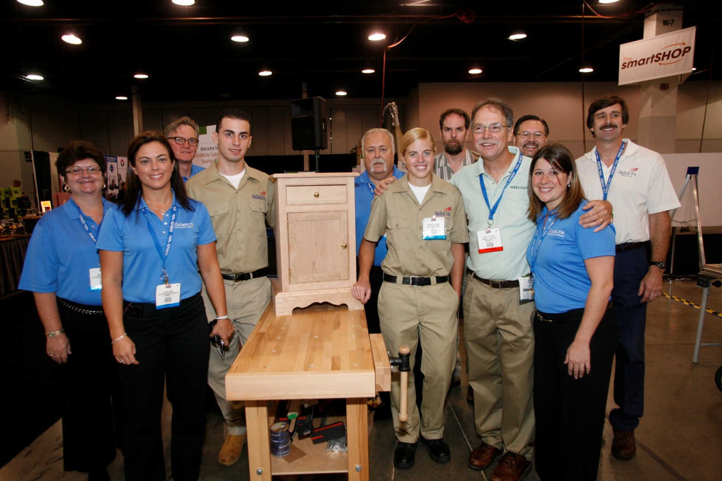
Start on your path today.
The woodworking and related
industries will welcome you!
Notes:
Photo from the 2011 AWFS Fair of the WorldSkills Cabinetmaking Qualifying team and sponsors.

Slide 40
This PowerPoint was prepared by:
Association of Woodworking &
Furnishings Suppliers® (AWFS)
A non-profit trade association based in Anaheim, CA, serving the suppliers to the commercial and residential furnishings industries. www.AWFS.org

