Slide 1


Advanced Manufacturing: It’s Not Grandpa’s Workshop Anymore!
Guiding Students to 21st Century Careers
Presented by:
Nancy Fister, Association of Woodworking & Furnishings
Suppliers (AWFS)
Patrick Molzahn, Madison Area Technical College
Adam Kessler, Datesweiser Furniture (NY)

Slide 2
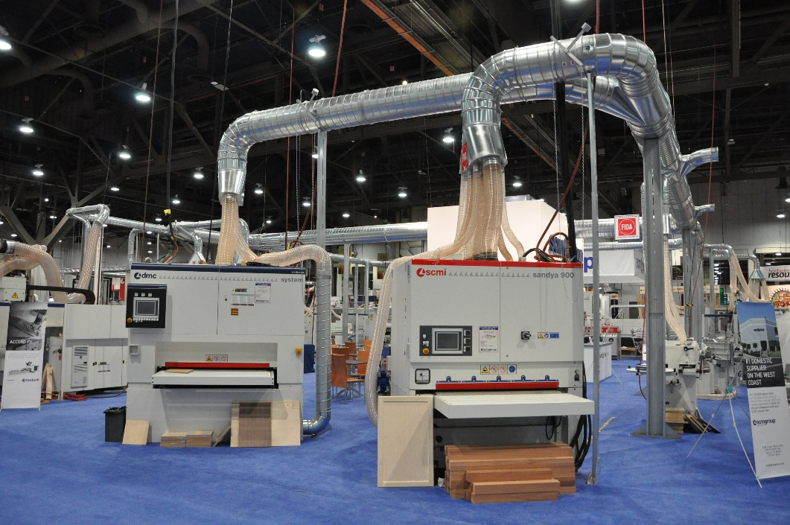
The Jobs vs. Workers Paradox
Over 2 million manufacturing jobs are expected to go unfilled in the next
decade. (The Manufacturing Institute)
From Jan. to June of this year, 68,000
mfg. jobs went unfilled each month,
according to government data.
And yet, 10% of 20-24 year-olds are unemployed.

Slide 3

Outdated Myths about Manufacturing
Skilled trades are for “the other”
Manufacturing is not for the college-bound
Jobs are rote, unskilled and offer little job security
Plants are dark, dirty, unpleasant places to work
Salaries are low
Advancement potential is limited

Slide 4


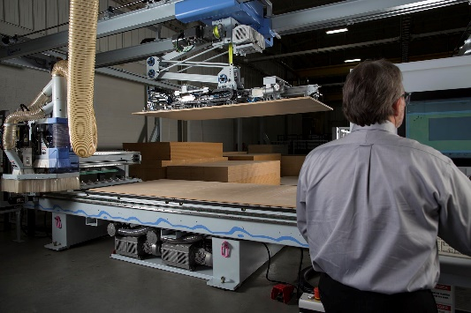
The Realities of Manufacturing
Manufacturing offers jobs at every skill and education level
It is totally modernized and high-tech
Skills are transferable to other industries
Plants light, bright, ergonomic
Salaries are competitive
Advancement is wide open

Slide 5
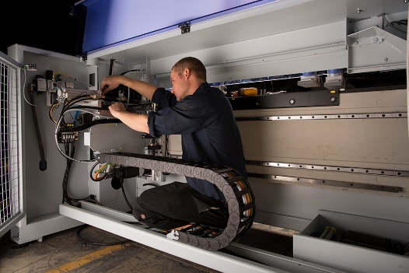
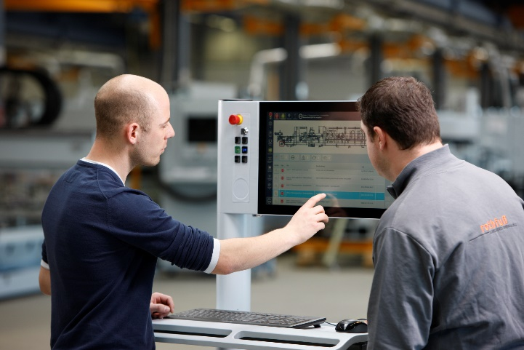
“It’s not a matter of IF I will hire them but how soon can I get them?” (quote from a manufacturer)
Computer Numerical Controlled (CNC) operators --Estimated 100,000 unfilled CNC jobs for mfg. in general; in 10 years, it will be 600,000
Sampling of job titles: Product designer -- Software engineer -- Mechanical operator – Technician -- Plant manager -- Finisher Quality manager -- Shipping/handling coordinator
(See resources for more titles)
In 1960, only 20% of the workforce was classified as “skilled trades.” In 2018, that number is estimated to be 57% (Harvard study)

Slide 6

What Can Counselors Do?
Develop an awareness of modern manufacturing and its opportunities –help dispel the myths
Reach out to your local instructors of applied technology courses
Show enthusiasm about the idea of a manufacturing career to students and parents; encourage them to explore.
Serve on AWFS Education Committee

Slide 7
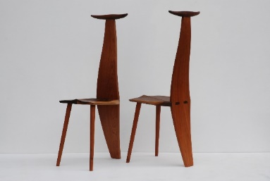
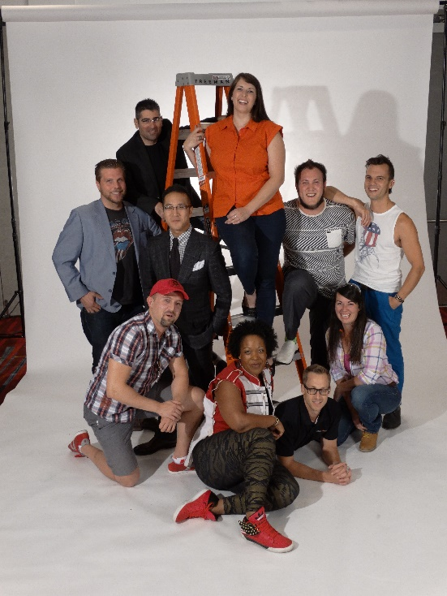
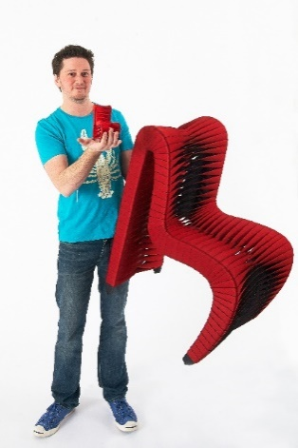
Guiding Students Who May be Interested
Encourage students to explore hands-on classes, connect with a SkillsUSA chapter or other student organization
Direct them to resources such as trade association web sites, trade shows, companies with training programs
Inspire them to take initiative on their own, such as seeking out information with community companies
Stress importance of soft skills to the business community

Slide 8
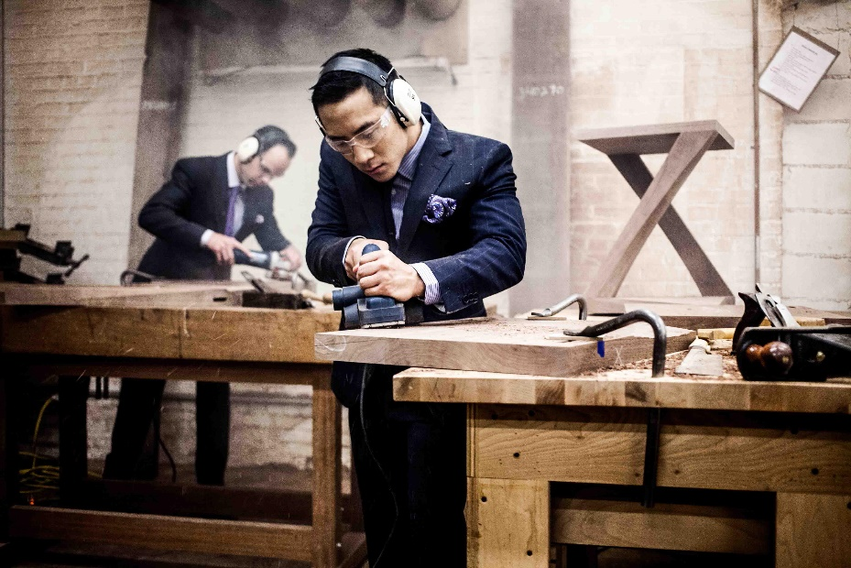
What to Tell Parents
Hands-on classes support STEM
Reshoring not off-shoring
Made in America revitalization—be part of growing the U.S. role as a global innovator
Chance for rapid advancement due to retiring personnel
Visit a company related to the student’s potential interests
Help child tap into “what do you like to do?” and “how to
apply those skills to be happy in a career?”
Bust the myth: It’s not menial and manual, it’s modern and mechanized!

Slide 9

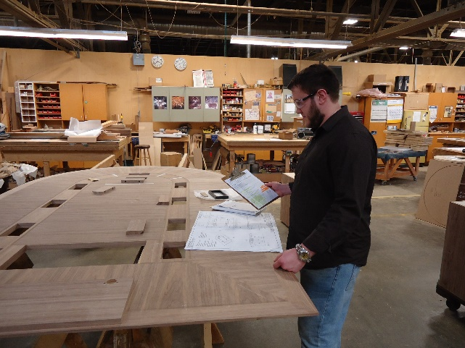
Relationship to Other classes
STEM –Applied courses directly support technology and engineering. Augment science and math and the A [Art] in STEAM]
CAD/CAM, the basis of adv. Mfg, is compatible with other skill-training areas such as computer programming, industrial design, graphic design
Manufacturing’s cutting edge technology is applicable not only in wood, metals, automotive and electronics, but also architecture, fine arts, geology, math, music

Slide 10
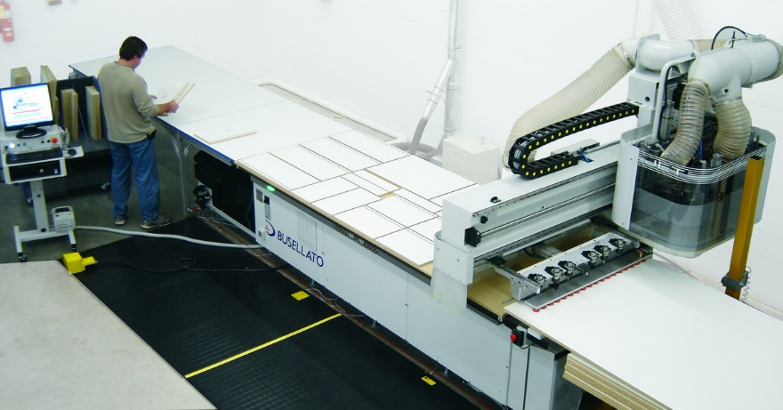
Modern Wood Manufacturing involves…
Hi-tech equipment
Problem-solving
Flexibility
LEAN solutions

Slide 11
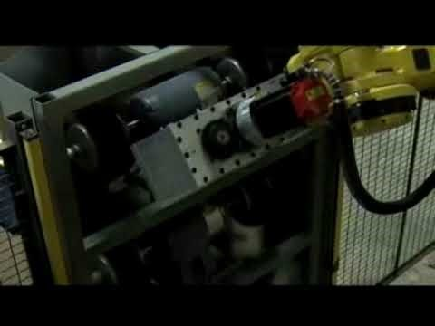
Future Trends
More automation
Faster production runs
Increased specialization

Slide 12
Skills & Traits Required (my program outcomes)
Follow standard safety procedures while operating and maintaining tools and machinery.
Produce high-quality products using appropriate tools and equipment, maintaining tolerances and standards while using time, motion, and materials efficiently.
Visualize, design, plan, and complete projects that meet clients’ expectations.
Interpret technical drawings and specifications necessary to create, modify, and assemble products.

Slide 13
Skills & Traits Required (my program outcomes, continued)
Communicate clearly and effectively with clients and co-workers.
Contribute to a dynamic and energetic workplace by following instructions, accepting responsibility, and working both collaboratively and independently, as required.
Engage in lifelong learning in order to advance technical, personal, and professional skills.

Slide 14
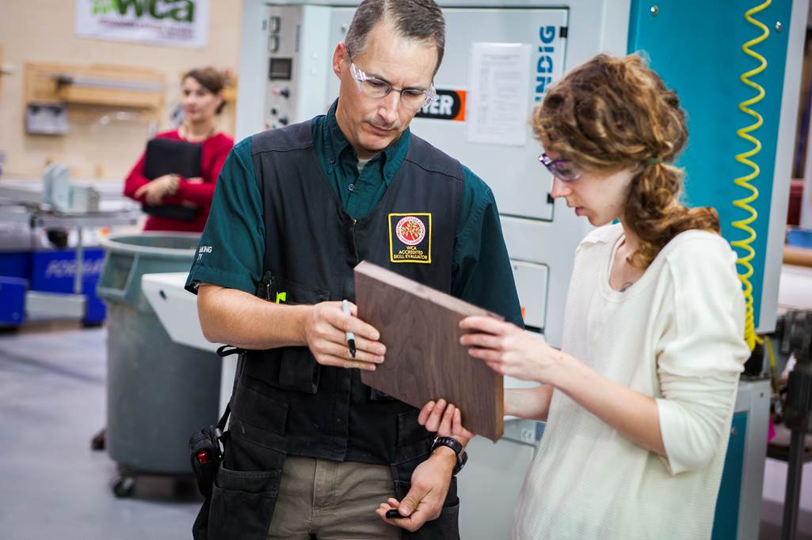
How does one become a professional woodworker and what can they earn?
Self-taught (school of hard knocks)
Secondary & post-secondary opportunities in the U.S. & Canada
Continuing education
Trade shows
Regional events & seminars
Training through machine manufacturers
Career potential
Salaries
Jobs

Slide 15

Learning Styles
HUMAN INSIGHT #1
HOW WE LEARN (AND BUY %):
83% through SIGHT
11% through HEARING
3 1/2% through SMELL
1 1/2% through TOUCH
1% through TASTE

Slide 16
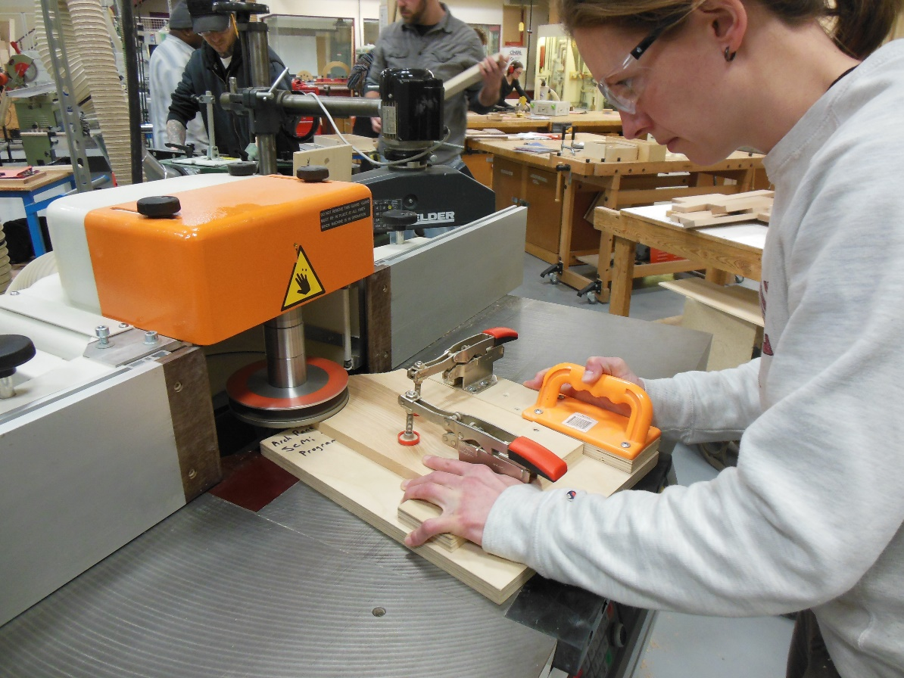
Learning Styles
HUMAN INSIGHT #2
HOW WE RETAIN INFORMATION:
10% OF WHAT WE READ
20% OF WHAT WE HEAR
30% OF WHAT WE SEE
50% OF WHAT WE SEE AND HEAR
70% OF WHAT WE SAY AS WE TALK
90% OF WHAT WE SAY AS WE DO A THING

Slide 17
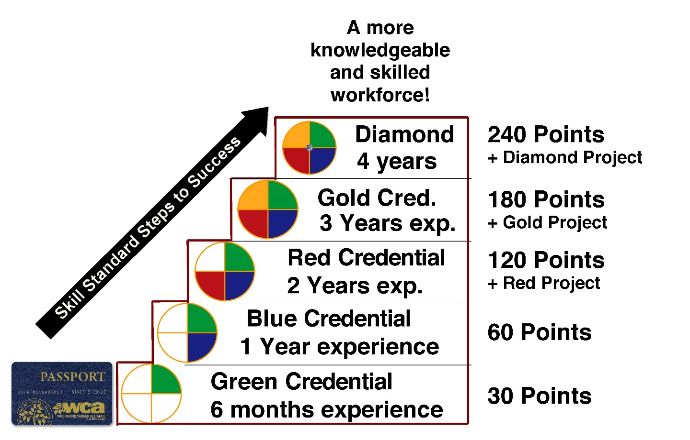
Woodwork Career Alliance (WCA)
What are the skill standards?
Why do we need them?
Why credentials?

Slide 18
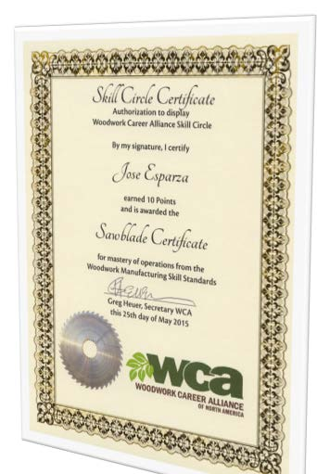

WCA EDUcation membership & Sawblade Certificate
Membership benefits
Sawblade award
Industry connections

Slide 19

A Success Story

Slide 20
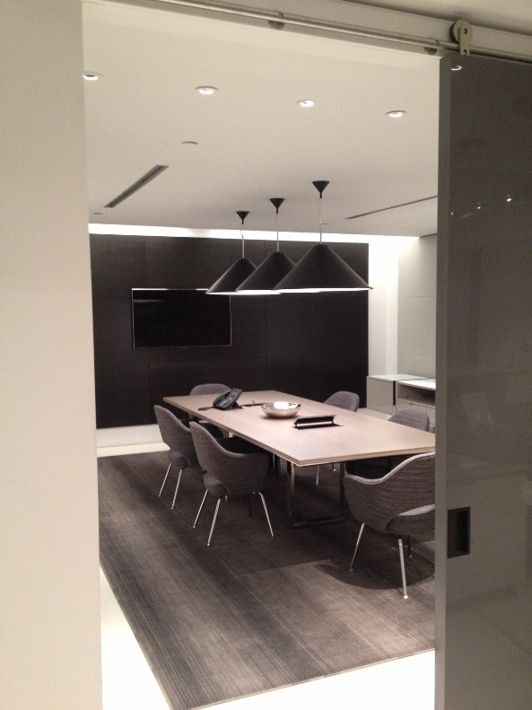
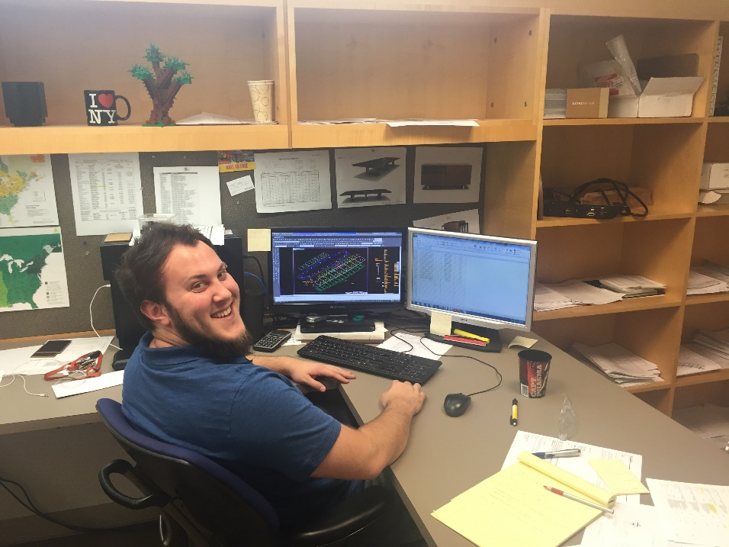
Adam Kessler: Profile
Datesweiser Furniture overview
Adam at Datesweiser:
Engineer
Estimator
Product Development
Project Management (current)

Slide 21
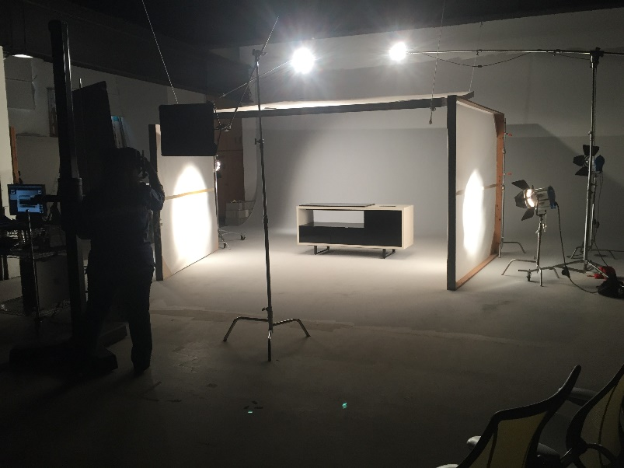
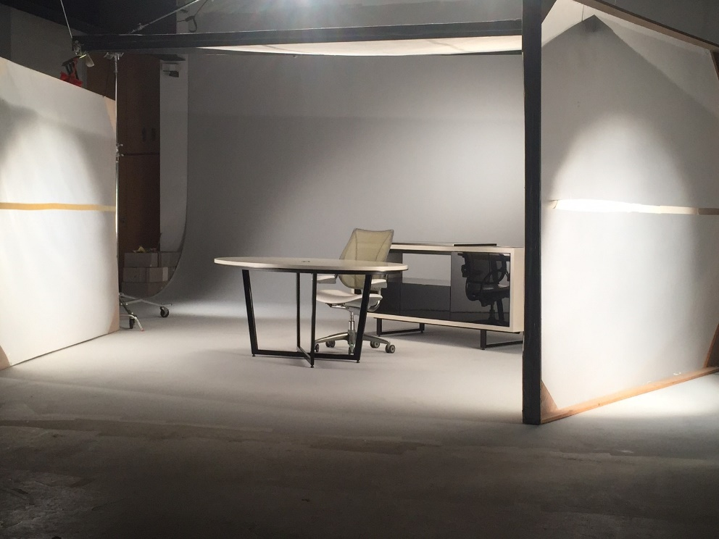
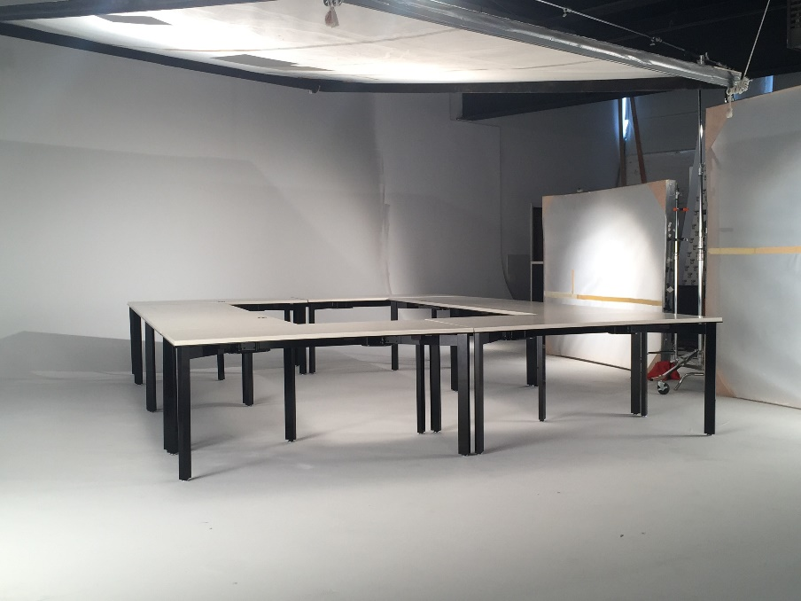
Product Development Task: Photo Shoot

Slide 22
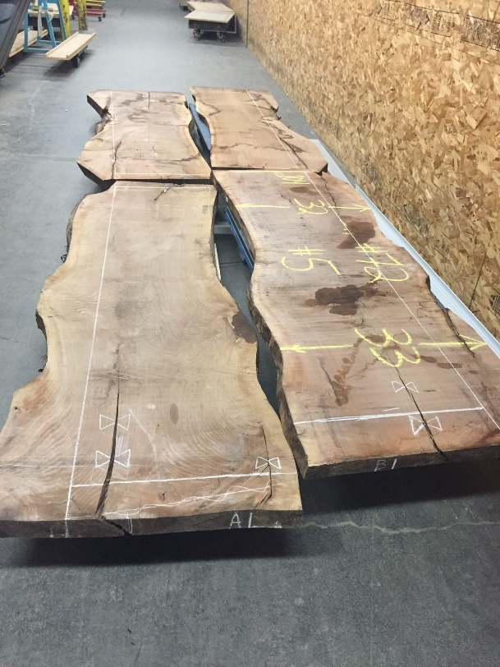
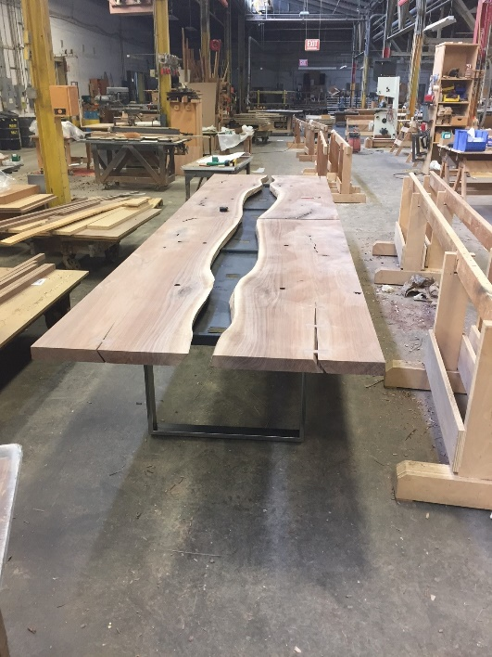
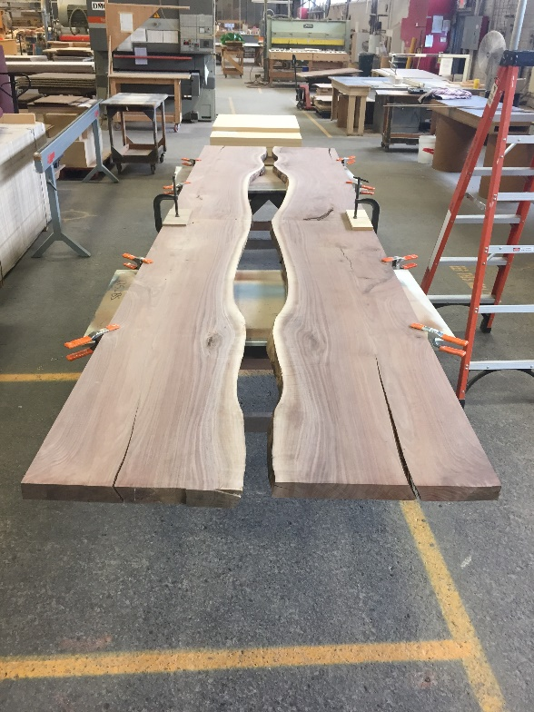
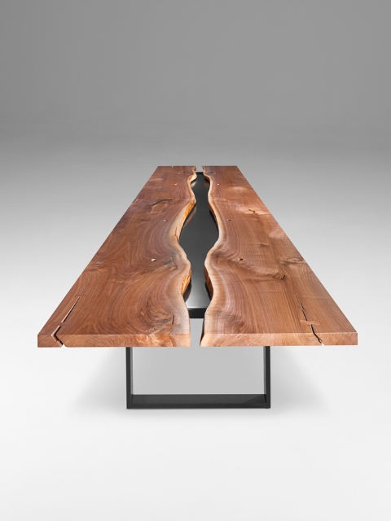
Custom Designed Projects

Slide 23
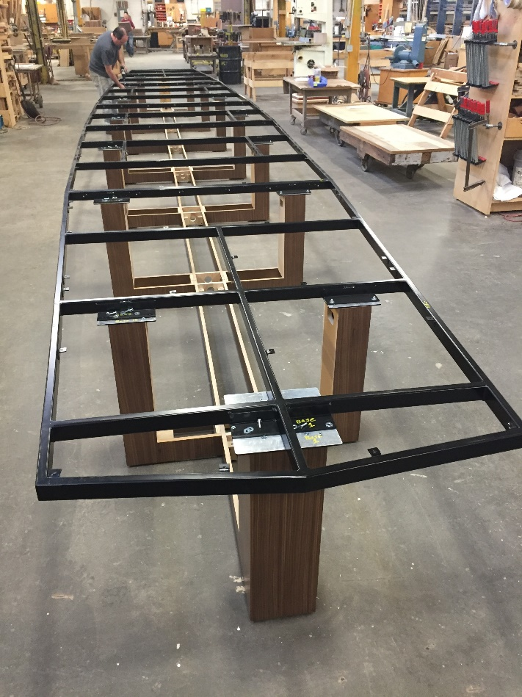
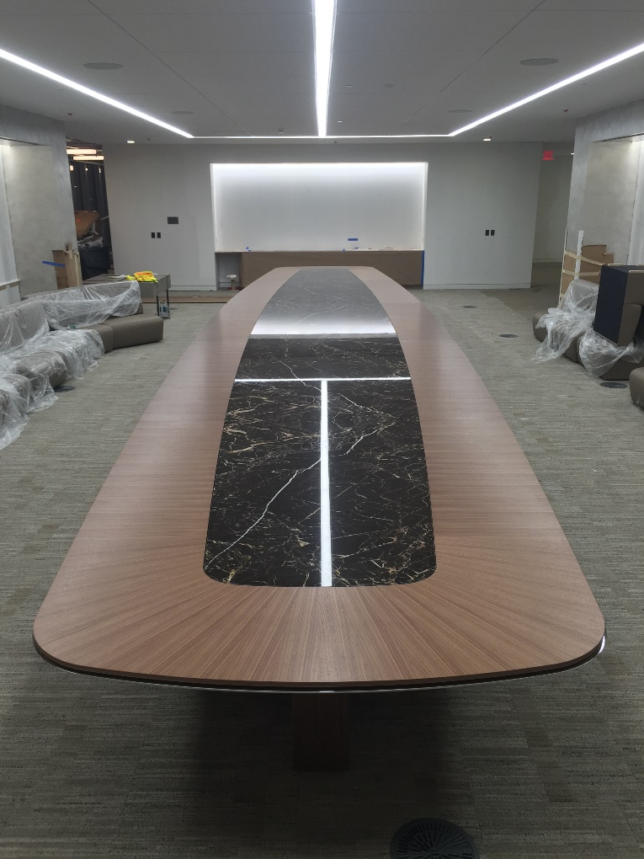
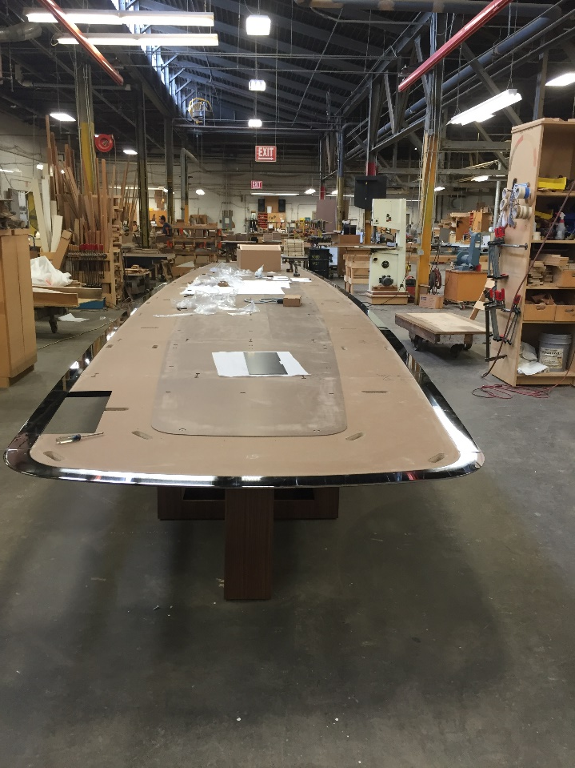
Project Management

Slide 24
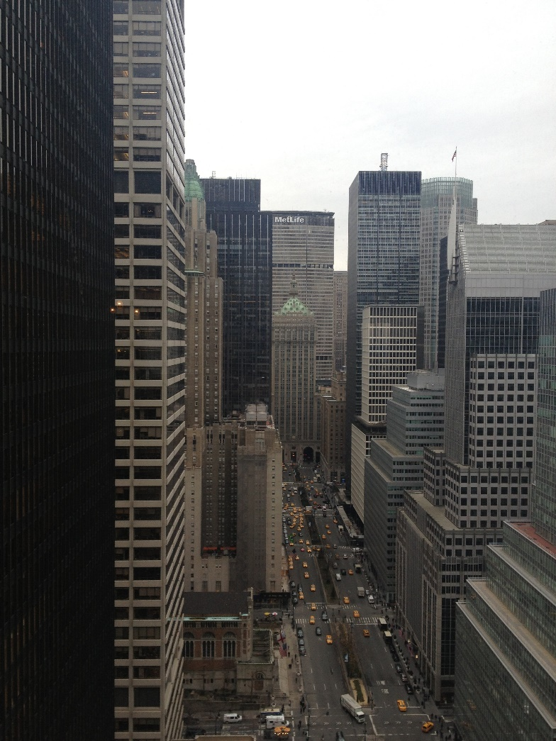
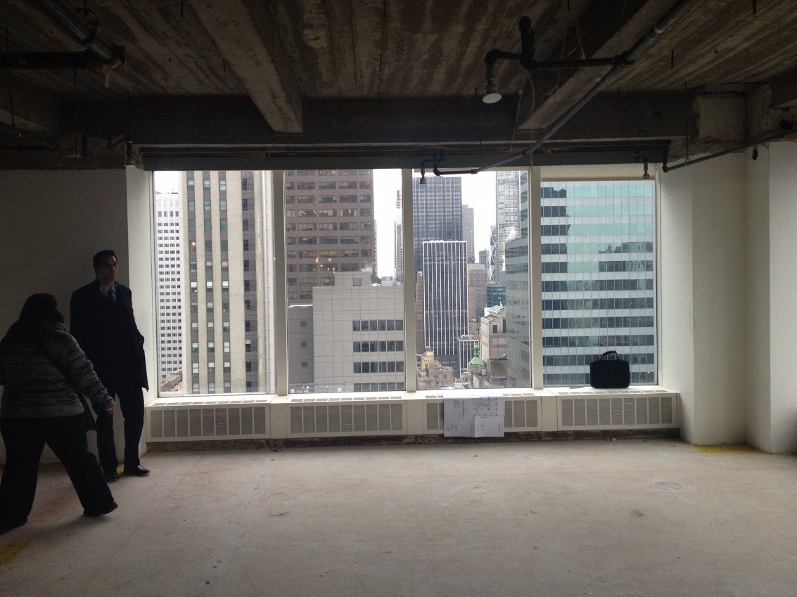
Project Management Task: Site Visits

Slide 25
Skills Used in Project Management
Soft Skills:
Written communication skills
People Skills and customer service
Critical thinking – “trying to think your way out of the box”
Organizational skills
Multi-tasking
Scheduling, developing timelines for projects
Business negotiating skills, working with dealers and others within supply chain
Software Skills:
Microsoft Office, especially Excel and general computer skills
CAD programs
Bluebeam, PDF programs
Industry-specific software (i.e. estimating and Visual Manufacturing) programs

Slide 26
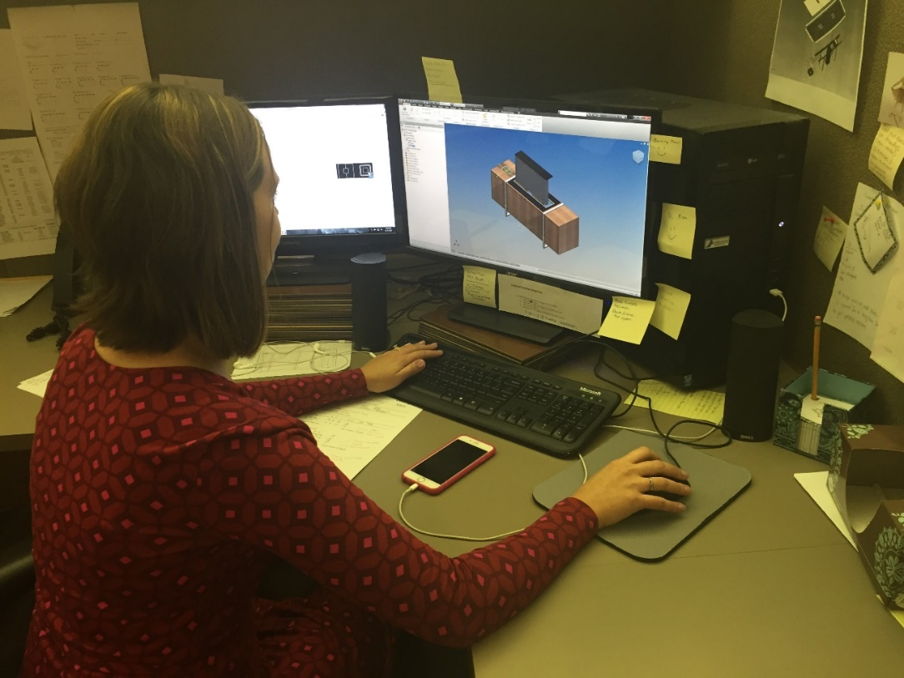
Other Positions at Datesweiser
Engineering
Estimating
Product Development
Project Management
Visualization
Purchasing
Sales
Drafting, post-secondary education required:
2 year CAD technical college program OR
4 year degree

Slide 27
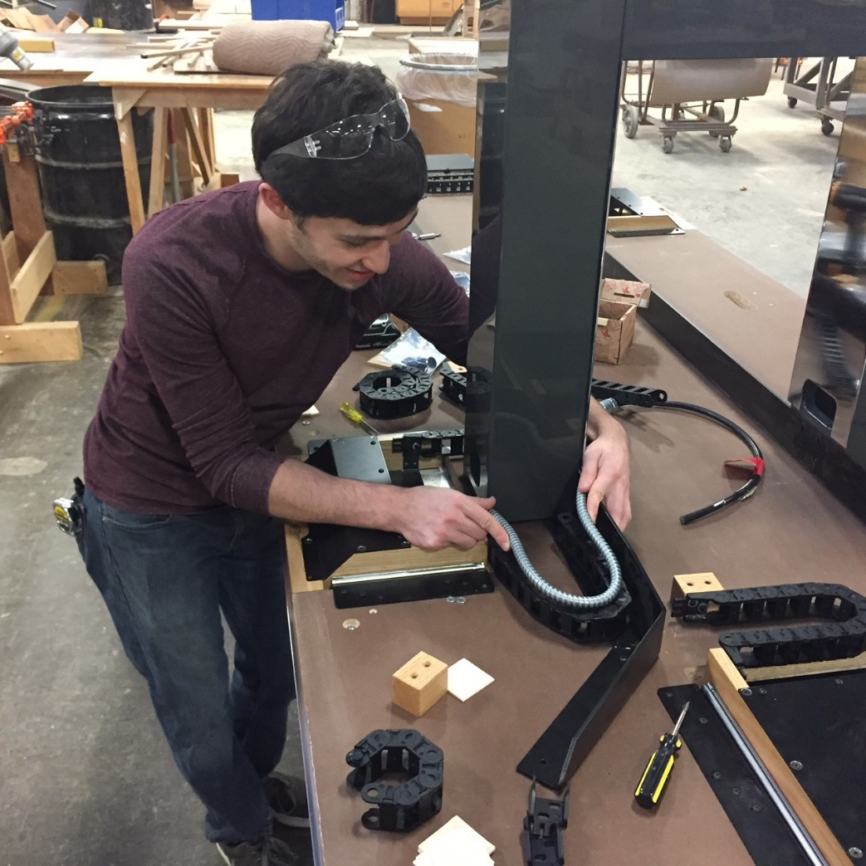
Other Positions: Engineer
Engineer Tasks:
Review the project designs
Calculate the tip points and structural stability of each table
Problem-solving
Develop mechanical components

Slide 28
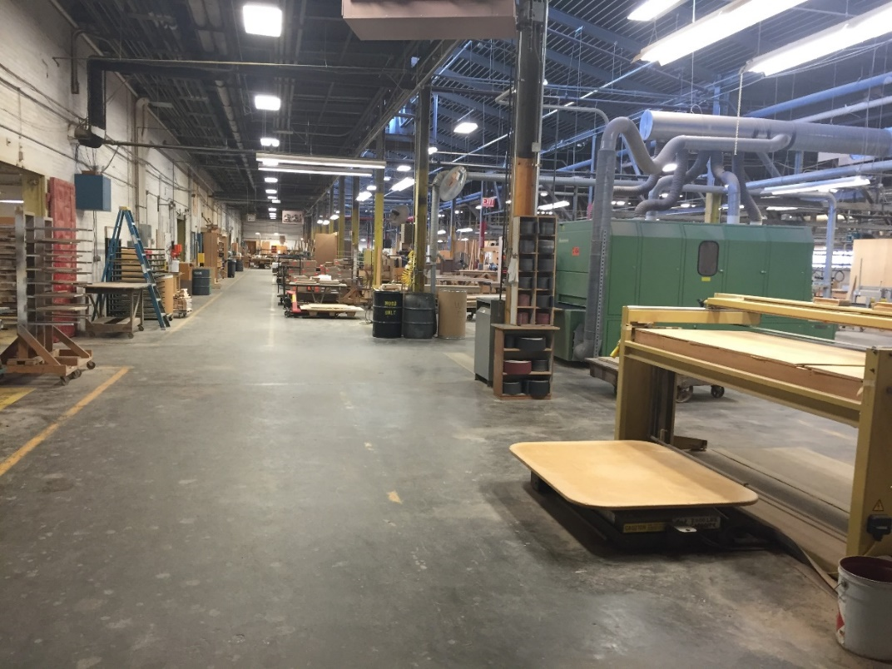
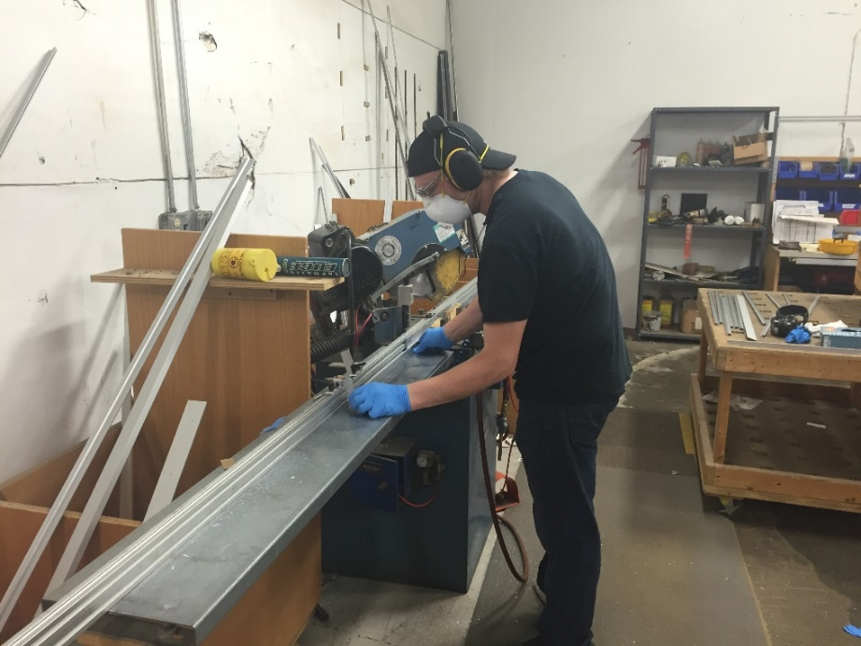
Other Positions at Datesweiser
In the shop/production:
Millworkers
Veneering Specialists
CNC Operators
Craftsmen
Metal Workers
Sanding
Finishing
Shipping

Slide 29







Other Types NY Wood Manufacturing-Related Companies
Hellman-Chang, New York, NY
CCN International, Geneva, NY
Kittinger Furniture, Buffalo, NY
Gunlocke Furniture, Dansville, NY
Artone Furniture, Jamestown, NY
Wrafter Built Furniture, Buffalo, NY
Nexis 3, Rochester, NY

Slide 30
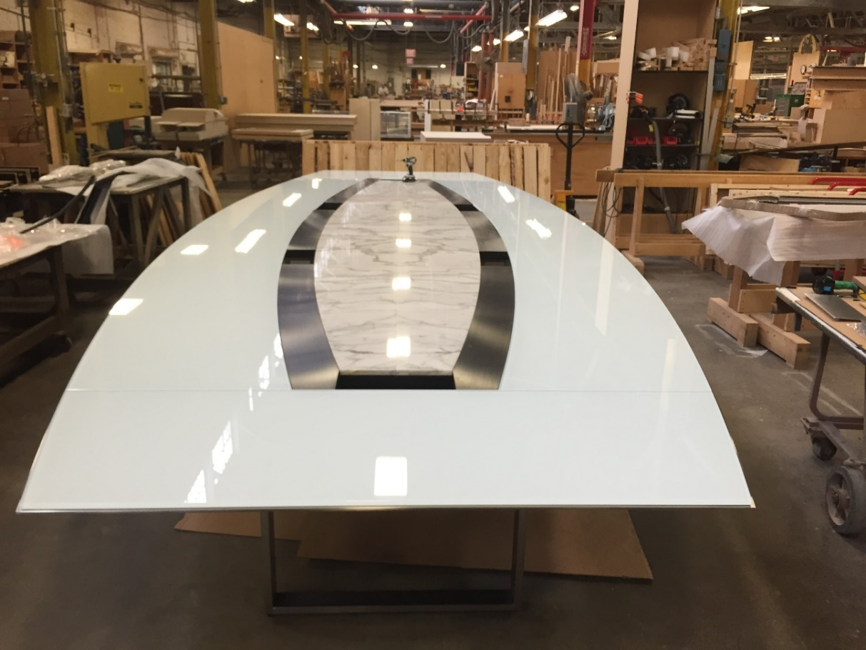
Other NY Manufacturing Companies: Vendors
Royal Metal, Surprise, NY
Ulrich, Buffalo, NY
Solid Surface, Rochester, NY
Advance Glass, Buffalo, NY
Garrett Leather, Buffalo, NY
Certainly Wood, East Aurora, NY
Amana Tool, Farmingdale, NY
James L Taylor Mfg., Poughkeepsie, NY

Slide 31

Resources
Resources for counselors, the classroom and students
www.AWFS.org/education
Information on Wood Manufacturing Skill Standards
www.woodworkcareer.org
Modern Cabinetmaking textbook
http://www.g-w.com/
4. MFG Day and other projects of the National Association of
Manufacturers www.themanufacturinginstitute.org
5. NYC High School Partnership with National Park Service
(bldg. trades and historic preservation)
www.matherhsnyc.org
6. Brooklyn Woods training program http://bwiny.org/
Implementation of WCA skill standards in NY: Northern Forest Center, Dave Redmond, 802-748-0101

Slide 32

Contact:
Nancy Fister, AWFS, nancy@awfs.org, 323.215.0303
Patrick Molzahn, MATC, pmolzahn@madisoncollege.edu, 608.246.6842
Adam Kessler, Datesweiser, akessler@datesweiser.com 585.465.9613
Please consider opening the eyes of students to the open
doors of manufacturing!

