Slide 1
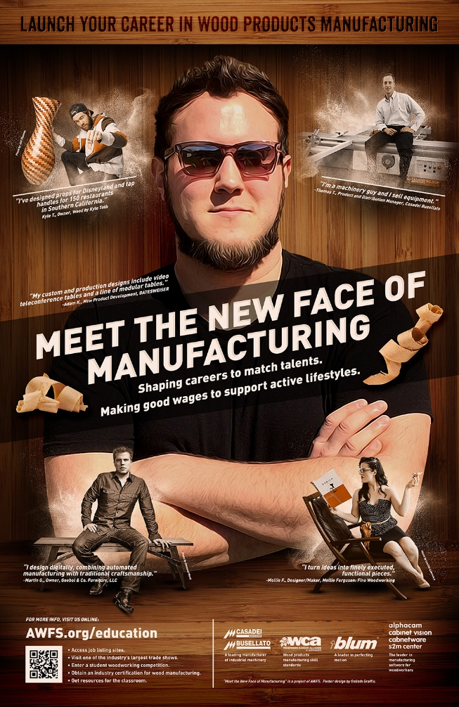


Meet the New Face of Manufacturing:
Guiding Students to 21st Century Careers
Presented by:
Adria Torrez, Assistant Education Director
Association of Woodworking & Furnishings
Suppliers (AWFS)
Anaheim, CA
Notes:
This is a presentation by the Association of Woodworking & Furnishings Suppliers (AWFS), intended to provide you with information about the wood products manufacturing industry and how you can help guide students to careers in this industry.

Slide 2
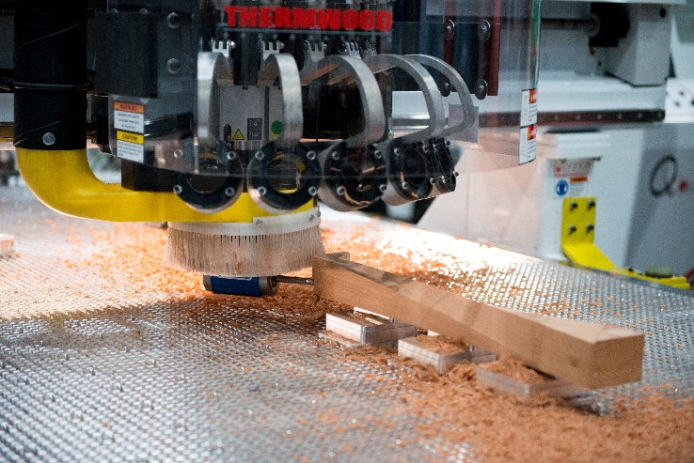
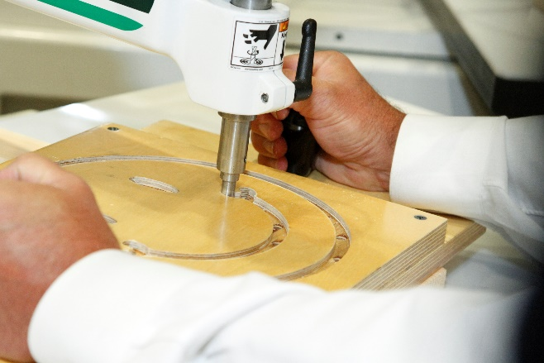
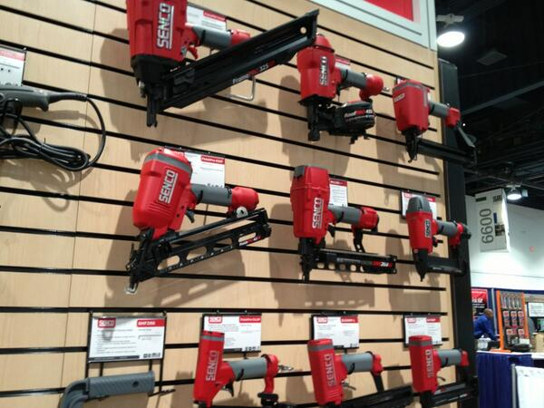
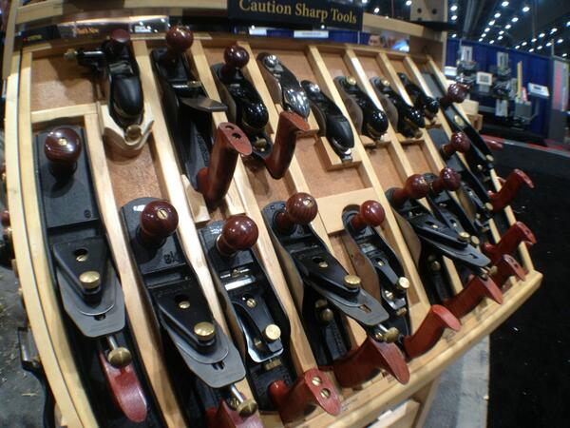
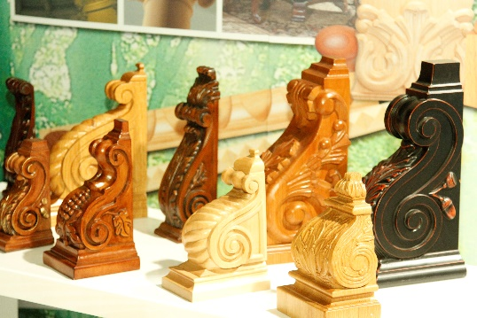
Who is AWFS®?
National trade association for the secondary wood products industry.
Our member companies are manufacturers of machinery and supplies for cabinetmakers, furniture makers, architectural millwork firms, and many others who produce with wood!
Strong focus in supporting industry education.
Notes:
AWFS represents companies who support wood manufacturers and owns and operates a biennial trade show for the secondary wood products industry. AWFS supports the growth of this industry through involvement in CTE activities and promotion of skilled trades, through various activities and events, including involvement in SkillsUSA California (through coordination of the state and regional woodworking contests)…and the Meet the New Face of Manufacturing campaign…

Slide 3
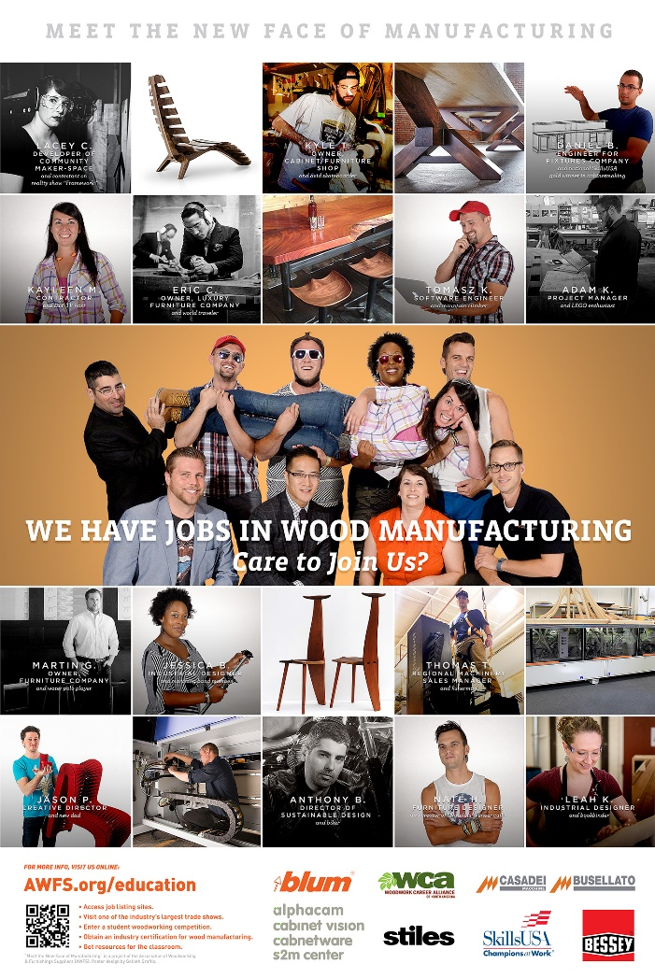

Meet the New Face of Manufacturing
Campaign launched in 2014 to CHANGE THE IMAGE OF WOOD PRODUCTS MANUFACTURING
Promote careers in wood products manufacturing:
  Dispel outdated myths about manufacturing
  Reach parents, students, legislators and others
Notes:
AWFS developed the “Meet the New Face of Mfg,” campaign to shake up, update and improve the image of jobs in mfg. We have developed two posters and a video, with the purpose of reaching out to students, teachers, counselors, administrators and parents—anyone in a position to influence young people making career choices-- with our message that there is a wealth of good jobs in manufacturing waiting to be filled. Outcomes: Over 4,500 requested posters distributed (for free); asked to do a webinar for New York State counselors; influenced other trade organizations to make support of CTE a main talking point with legislators on their fly-ins to Washington D.C.

Slide 4
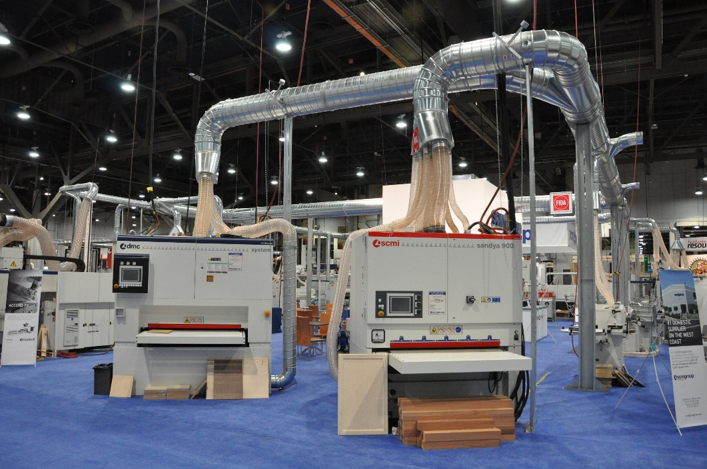
The Jobs vs. Workers Paradox
Over 2 million manufacturing jobs are expected to go unfilled in the next
decade. (The Manufacturing Institute)
From Jan. to June of 2015, 68,000
mfg. jobs went unfilled each month,
according to government data.
And yet, 10% of 20-24 year-olds are unemployed.
Notes:
Looming Baby boomer retirement in mfg. is creating a mega-opportunity for the next generation. Mfg. remains one of the greatest contributors to the economy but the labor situation is almost desperate, even as 10% of young adults are unable to find employment!
Mfg. has changed significantly in the last decade but it has not adequately marketed itself as an employer. The outdated image of mfg. is a major recruitment problem.
What are the outdated ideas about mfg?...

Slide 5

Outdated Myths about Manufacturing
Skilled trades are for “the other”
Manufacturing is not for the college-bound
Jobs are rote, unskilled and offer little job security
Plants are dark, dirty, unpleasant places to work
Salaries are low
Advancement potential is limited
Notes:
These are the myths we are trying to dispel!
As you well know, historically, individuals who show aptitude for or interest in skilled trades are “classified” as somehow “less than” college-bound (less smart, less likely to succeed). However, a survey of engineers showed they credited hands-on courses as one of the most impactful elements of their education.
We regularly encounter students who are valedictorians/salutatorians, and professionals who are highly educated and successful in the woodworking industry!

Slide 6


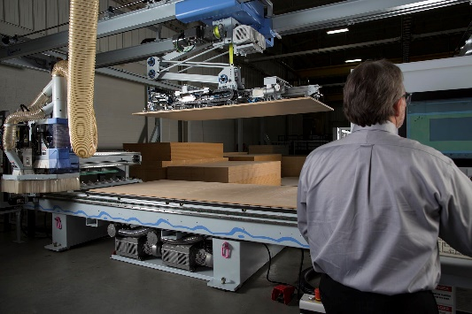
The Realities of Manufacturing
Manufacturing offers jobs at every skill and education level
It is totally modernized and high-tech
Skills are transferable to other industries
Plants light, bright, ergonomic
Salaries are competitive
Advancement is wide open
“It’s not a matter of IF I will hire them but
how soon can I get them?” (quote from a manufacturer)
Notes:
This is a snapshot of modern manufacturing:
Job opportunities vary from entry level (straight from high school), to those requiring more training and education. It is not an either/or of college or mfg. Some interesting industry-education partnerships are being developed. One of our member companies, which is the largest woodworking machinery company in No. America, offers extensive training programs in advanced manufacturing and has teamed up with Pittsburg State in Kansas to create college credit courses.
The wood indus, like the other mfg. sectors, uses current and advanced technology, such as CNC (computer numerical controlled) equipment, design and production software, 3D printing and other advanced equipment. Robotic machines do the heavy lifting—even pulling inventory overnight to have it ready for the morning.
CNC skills are highly desirable and the mean wage for CNC tool programmers is $50,000 per Bureau of Labor Stats.(Enterprising individuals might also pick up a related skill e.g. welding.)
Plants are not “dirty and dingy” like old steretypes— Blum, Inc. is a large manufacturer of sophisticated cabinet hardware (drawer slides, hinges) and they have a cutting edge apprenticeship program with 4 full-time employees to run it; ergonomic stations in plant, bright cafeteria with skylights and an art gallery!
Salaries vary with geographic location, company size, job title. Entry level for our industry is in the $15-18 range; for mfg. overall $34/hr (per Mfg. Institute). Mechanical engineering/industrial production manager in the $80-90,000 range.
The percent of workforce classified as “skilled trades” is on the rise, estimated to be 57% in 2018.

Slide 7

What Can You Do?
Develop an awareness of modern manufacturing and its opportunities –help dispel the myths
Reach out to local industry (teachers) or local instructors (counselors) of applied technology courses. Share info on reaching out to local industry for tours, guest speaking, externships/internships or other partnership opportunities
Show enthusiasm about the idea of a manufacturing career to students and parents; encourage them to explore.
Notes:
Begin to build your own arsenal of resources to correctly inform students of the hi-tech, challenging, computer driven realities of today’s mfg.
If you are a counselor, contact your local CTE instructors, if you are a teacher, reach out to industry to build partnerships.
Our web site may provide some inspiration. Look to mfg. trade associations, trade shows, SkillsUSA, other trade competitions.
Get students excited about growing and innovating American manufacturing.

Slide 8
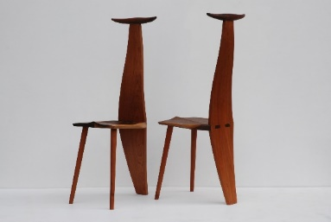
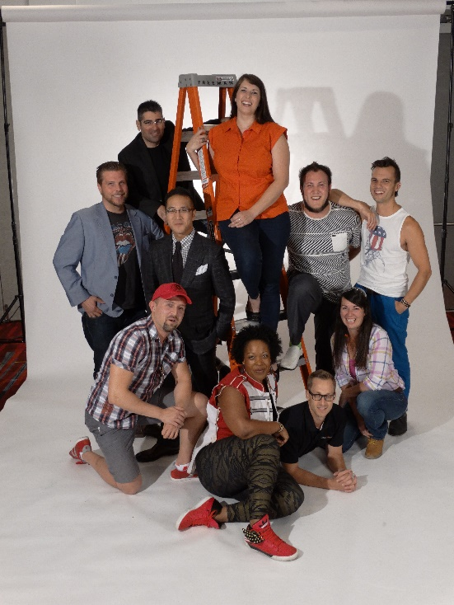
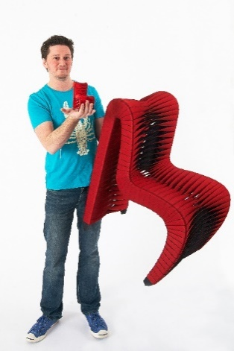
Guiding Students Who May be Interested
Encourage students to explore hands-on classes, connect with a SkillsUSA chapter or other student organization
Direct them to resources such as trade association web sites, trade shows, companies with training programs
Inspire them to take initiative on their own, such as seeking out information with community companies
Stress importance of soft skills to the business community
Notes:
Help students see a potential match with their strengths and skills with opportunities in manufacturing (SkillsUSA could be very helpful with this!)
We have resources available for our industry but they may also give you ideas of where to look for resources in other mfg. sectors.
Students also need to shed the stigma of skilled trades jobs. With a positive outlook, you can turn a passive student into a self-directed one. Remind students that it’s OK to explore even if it takes a little guts! You ca help them prepare!
Soft/leadership skills are huge for employers! (Showing responsibility, reliability, teamwork, communication skills.) Students with these traits, have a huge leg up.

Slide 9
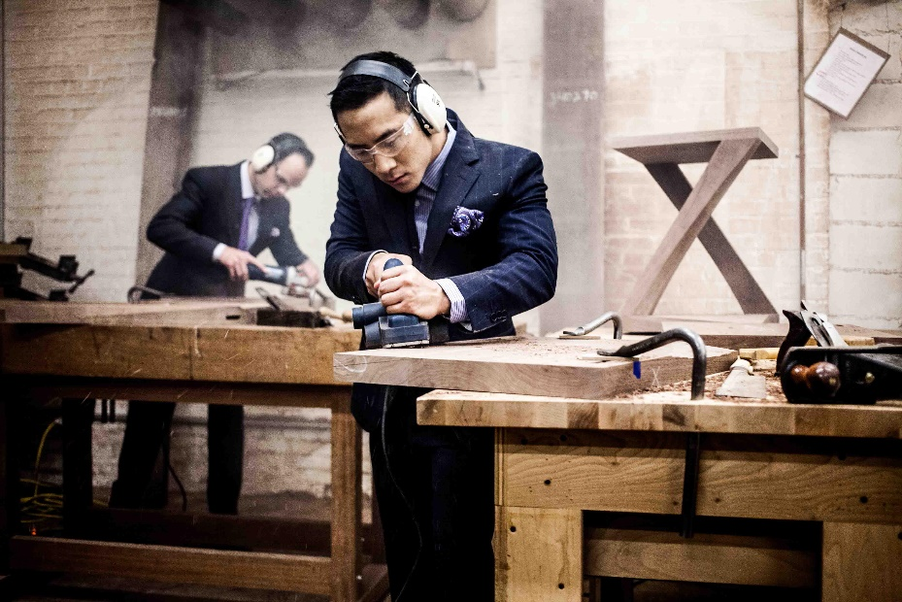

What to Tell Parents
Hands-on classes support STEM
Reshoring not off-shoring
Made in America revitalization—be part of growing the U.S. role as a global innovator
Chance for rapid advancement due to retiring personnel
Visit a company related to the student’s potential interests
Help child tap into “what do you like to do?” and “how to
apply those skills to be happy in a career?”
Bust the myth: It’s not menial and manual, it’s modern and mechanized!
Notes:
Parents misconceptions about mfg. could be holding students back from maximizing their potential. Educate parents that “applied learning” reinforces STEM.
We are in a period of RE-SHORING. In a Mfg. Institute survey, ½ of executives indicated plans to re-shore some portion of their operation by 2020. IKEA recently built a plant in the U.S.!
Students who apply themselves can write their own ticket. Encourage students to be pro-active. Visit companies with students. Ge the facts.
Bottom line message about manufacturing jobs: It’s not menial and manual, it’s modern and mechanized!

Slide 10

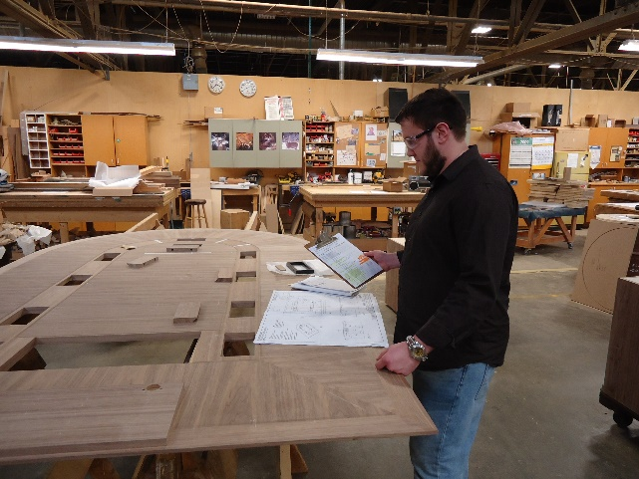
Relationship to Other classes
STEM –Applied courses directly support technology and engineering. Augment science and math and the A [Art] in STEAM]
CAD/CAM, the basis of Adv. Mfg, is compatible with other skill-training areas such as computer programming, industrial design, graphic design
Manufacturing’s cutting edge technology is applicable not only in wood, metals, automotive and electronics, but also architecture, fine arts, geology, math, music
Notes:
One woodworking student told us his math classes now made sense within the context of CTE.
Hi-tech equipment is used for model making in various fields; topographical maps; sculpture, musical instruments (many in our competition).
Mfg. has reinvented itself. Students can be a part of the exploration and innovation.

Slide 11

Resources
Resources for instructors, administrators, students and others -- www.AWFS.org/education
Information on Wood Manufacturing Skill Standards
      www.woodworkcareer.org
Modern Cabinetmaking textbook
      http://www.g-w.com/
      Manufacturing Day and other projects of the
      National Association of Manufacturers; issues
      reports with great info and stats -- www.mfgday.com
      www.themanufacturinginstitute.org
      Wood Mfg. trade press
      www.WoodworkingNetwork.com
Notes:
On our resource page AWFS.org/education, we have a couple PPT presentations, including one that profiles various careers; documents with lists of job titles, a glossary of industry terms, and industry events and organizations. You can also find info on our student woodworking competition and seminars at our trade show that are appropriate for teachers and students;
The Woodwork Career Alliance is recognized by the CDE as an industry standard. Educators can become passport evaluators and students can earn passport stamps while in high school.
Modern Cabinetmaking is THE textbook for industry/production-focused wood manufacturing programs. It was just updated and incorporates current industry practices and standards.
Participate in Manufacturing day, the first Friday in October – many companies open for tours!
WoodworkingNetwork.com is THE website for industry news and current information.

Slide 12

Contact:
Nancy Fister, AWFS, nancy@awfs.org, 323.215.0303
Adria Torrez, AWFS, adria@awfs.org, 323.215.0311
Thank you for your support of CTE and opportunities in manufacturing industries!

